Slide 1
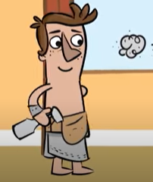
Joseph was being accused of doing bad things to Potiphar’s wife and was imprisoned. In the midst of dangers and adversities, God protected him because of his faithfulness. Joseph may not have seen the overall picture of God’s plan in his life, yet he remained faithful to God instead of complaining and embracing the culture of the people of Egypt. In return, the Lord cared for him.
God cares for me, I am…

Slide 2
Joseph was a diligent young man. When he was taken to Egypt as a slave, he worked hard in Potiphar’s house. When in prison, he excelled to the point he was able to help the Pharaoh. Joseph reminds us to always do your best. We should always give ourselves fully to the work of the Lord because we know that our labor in the Lord is not in vain.
God is always with me, I am…

Slide 3
Joseph never lost his faith in God and always made the best out of the bad situations he was put in. No matter where we are in life, God wants us to do our best! Because
God is always with me, I am…

