Slide 1

Lifelong Faith Formation: Vision, Practices, Plan
John Roberto - Lifelong Faith Associates

Slide 2
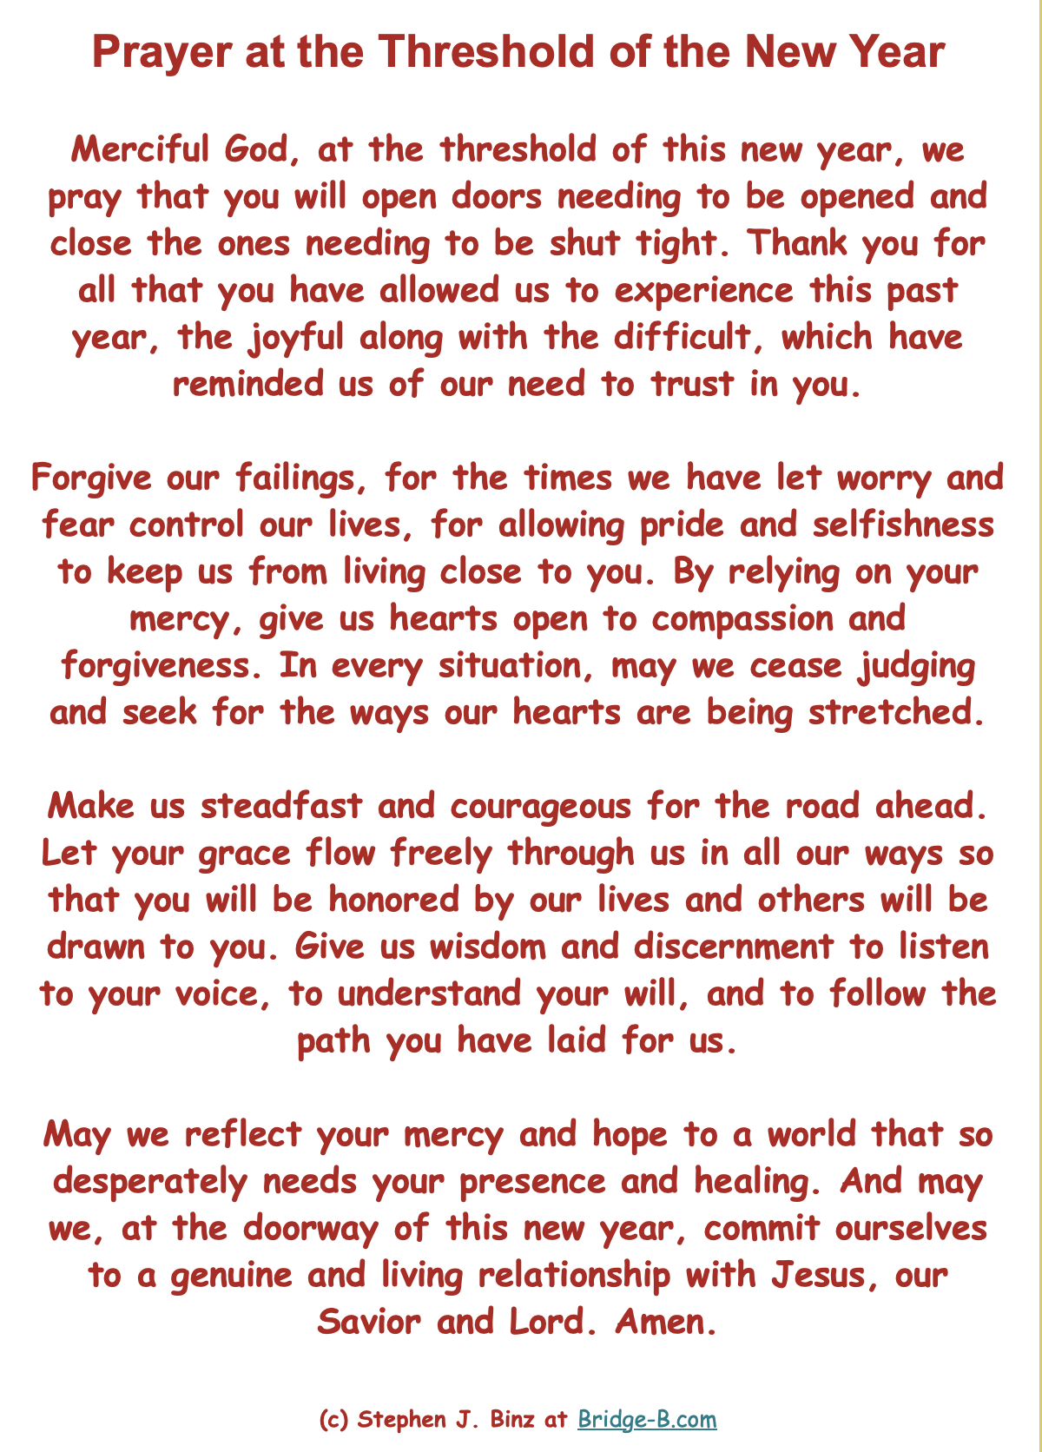

Slide 3
Dates
The cohort will meet at 10:00am (eastern) on dates below:
Wed, Jan 10
Wed, Feb 7
Wed, March 6
Wed, April 10
Wed, May 8
Wed, June 5

Slide 4
Developing a Lifelong Plan
Establish goals for lifelong faith
Explore using a model of lifelong faith
Target specific audiences
Develop a plan and programming for target audiences
Implement
Develop a profile
Develop a multi-year blueprint for lifelong faith formation

Slide 5
Lifelong learning is the new normal. It is the recognition that learning never stops as we mature and age.

Slide 6
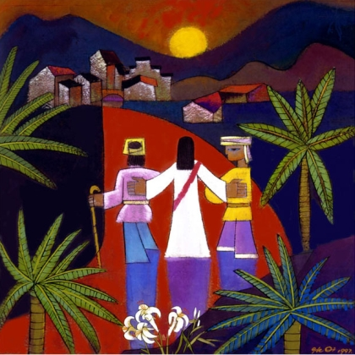
Lifelong faith formation is accompanying people throughout life as they mature in faith and discipleship, learn more deeply about the Christian faith and how it informs and forms their lives today, and practice their Christian faith in all the arenas of their lives.

Slide 7
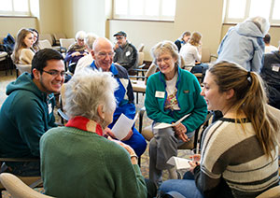
Church as a Community of Learners
Where everyone is a teacher and everyone is a learner
Accompanying each other

Slide 8
How can a church become a center for lifelong learning and faith formation for all ages and generations?

Slide 9
Expectations / Outcomes
How to involve more of my leaders in making lifelong faith formation this a regular part of church life? Build investment
What are our goals? We have a vision statement – connect, grow, serve – what do those mean? Common language and vision
Involve the community in service, focus on children and older adults, gap with families, midlife adults (30-50)
Create a framework to picture long term vision – build on strengths, identify areas for growth; allocate time and develop leadership team
Commit to stop working in siloes, figure out a model to invest in, and convince the community; cohort a place of accountability, encouragement
Working on a blueprint we all can work on, have a connection, a priority for all of us
Making our staff see how important this for our church and our sustainability
Leadership structures, leaders for ministries/ages, volunteer leadership,
How to stop doing things and process

Slide 10
Vision & Practices of
Lifelong Faith Formation

Slide 11
Lifelong through the Seasons of Life
Children
Teens
Young Adults
Older Adults
Midlife Adults
Mature Adults
40s-50s
0-5
6-10
11-14
14-18
20s-30s
60s-70s
80+

Slide 12

Lifelong Faith Maturing
Faith matures over a lifetime. Discipleship and learning is lifelong. At each stage of life people have new religious and spiritual needs and challenges, which often find resolution in the next stage of life.

Slide 13
Goals for Maturing in Faith
Goals
Jesus
Discipleship
Bible
Beliefs & Teachings
Prayer & Spiritual Life
Moral Living
Service, Justice, Creation
Worship & Church Seasons
Community Life
Gifts & Talents

Slide 14
Maturing in Faith for a Lifetime
Children
Teens
Young Adults
Older Adults
Midlife Adults
Mature Adults
40s-50s
0-5
6-10
11-14
14-18
20s-30s
60s-70s
80+
Jesus
Discipleship
Bible
Christian Beliefs
Prayer
Morality
Service & Justice
Worship
Community
Gifts

Slide 15
Lifelong & Continuous
Children
Teens
Young Adults
Older Adults
Midlife Adults
Mature Adults
40s-50s
0-5
6-10
11-14
14-18
20s-30s
60s-70s
80+
Children
Adolescents
Young Adults
Midlife Adults
Mature Adults
Older Adults

Slide 16
Lifewide
Life
Situations
&
Context
Religious & Spiritual Life
Life Stage Tasks
Children
Teens
Young Adults
Older Adults
Midlife Adults
Mature Adults
40s-50s
0-5
6-10
11-14
14-18
20s-30s
60s-70s
80+

Slide 17
Inclusive
Not Spiritual, Not Religious
Unaffiliated
Spiritual but Not Religious
Uninvolved
Moderate Faith Practice & Occasional Engagement
Occasionals
Vibrant Faith & Engagement at the Center of Life
Actives

Slide 18
Three Environments of Faith Forming
Intergenerational Experiences
Family Experiences
@ Home and @ Church
Age-Group Experiences
Intergenerational
Family
Peers or
Life Stage

Slide 19
Intergenerational Experiences
At every stage of life people need to be connected to other generations and have intergenerational faith forming experiences
Connecting with Generations
Multigenerational to Intergenerational
Age-Specific to Intergenerational
New Intergenerational
Programming
Neighborhood and Community

Slide 20
Family & Parent Formation
Family Faith Formation
Focus on parents
Focus on home life
Focus on faith practices
Focus on parent’s relationship with child and parenting style.

Slide 21
Diverse Programming
A menu of faith-forming experiences for families and individuals in intergenerational, family, and life stage settings
A variety of content, programs, activities, and resources to address a diversity of needs
A variety of formats: on your own, mentored, at home, in small groups, and in large groups
A variety of settings: in-person, online, and hybrid
A variety of schedules: in-person, online, hybrid
Available anytime & anywhere

Slide 22
Through the Seasons of Life
Children
Adolescents
Young Adults
Midlife Adults
Mature Adults
Older Adults
What are the life tasks and life transitions in each season of life?
What are people’s spiritual and religious needs, hungers, interests, concerns in each season of life?
How can we promote growth in faith & discipleship in each season and for a lifetime?

Slide 23
Faith Formation for the
First Two Decades of Life
Young Children
Family @ Home + Church
Older Children
Family @ Home + Church
Young Adolescents
Family @ Home + Church
Older Adolescents
Family @ Home + Church
Intergenerational
Intergenerational
Intergenerational
Intergenerational
Age-specific
Age-specific
Age-specific
Age-specific
Family @ home and church experiences
Intergenerational faith forming experiences
Age-specific experiences
Variety of content, experiences, settings
In-person-online-hybrid
Family faith practices
Milestones
Church year seasons
Parenting practices and skills
Parenting for faith growth
Family-centered gatherings and programs at church

Slide 24
Families with Children 0-5
Baptism preparation that engages the parents in their own faith growth and prepares them for nurturing faith in young children
Mentors from the church community (e.g., grandparents) to accompany parents on the journey from Baptism to start of school
Faith practices - Bible stories, prayers, meal rituals, values
Seasons of the year activities
Milestones - birthdays, baptism anniversaries, “first” milestones, entry to preschool and kindergarten
Parenting knowledge - understanding young child development and practices for effective parenting of young children
Parenting for faith skills - reading a Bible story, praying with a young child, having faith conversations
Online group for parents of young children
Gatherings for parents and for families at church
At Church
At Home
Online
Hybrid

Slide 25
Faith Formation for the
Seasons of Adulthood
Young Adults
Midlife Adults
Mature Adults
Older Adults

Slide 26
Faith Formation for the
Seasons of Adulthood
1. Focus on people’s lives and religious needs
2. Address the diversity of adult faith and religious/spiritual practice
  Vibrant faith and active engagement
  Occasional engagement and faith is less central to life
  Spiritual, but not engaged with a faith community
  Unaffiliated, uninvolved, religion not important
3. Develop formation around . . .
  Adult life tasks & transitions
  Scripture
  Beliefs
  Liturgy & worship
  Justice & service
  Prayer & spiritual life
  And more

Slide 27
Faith Formation for the
Seasons of Adulthood
4. Tailor faith formation to the adult faith profiles
  Taste & See Experiences
  Refresher Experiences
  Growing Experiences
  Go Deeper Experiences
5. Provide a variety of offerings and programming
  Content, programs, activities
  Formats—on your own, mentored, small groups, and large groups
  Times to participate and scheduling options (synchronous and asynchronous)
  Hybrid, online, and gathered

Slide 28
Personalized
Develop pathways of faith formation tailored to the four spiritual-religious identities
  Actives: people of vibrant faith and engagement
  Occasionals: people of moderate faith and occasional engagement
  Spirituals: people who are spiritual but not religious
  Unaffiliated: people who are not spiritual and not religious
Offer content, experiences, and activities tailored to different spiritual-religious identities

Slide 29
Goals for Lifelong
Faith Formation

Slide 30
Activity
Activity: Your Church’s Vision of Maturing in Faith
What are your church’s goals (vision) for lifelong maturing in faith and discipleship for all ages and generations?
What would you change/revise/add to your church’s goals for lifelong maturing in faith ?
Reflection & Application
How do your goals for maturing in faith inform or guide faith formation with all ages and generations? How do you see these goals reflected in your practice of lifelong faith formation?
How can your vision of maturing in faith inform what you are trying to accomplish in the lives of people at each stage of life from childhood through older adulthood?

Slide 31
Goals for Maturing in Faith
Goals
Jesus
Discipleship
Bible
Beliefs & Teachings
Prayer & Spiritual Life
Moral Living
Service, Justice, Creation
Worship & Church Seasons
Community Life
Gifts & Talents

Slide 32
Maturing in Faith for a Lifetime
Children
Teens
Young Adults
Older Adults
Midlife Adults
Mature Adults
40s-50s
0-5
6-10
11-14
14-18
20s-30s
60s-70s
80+
Jesus
Discipleship
Bible
Christian Beliefs
Prayer
Morality
Service & Justice
Worship
Community
Gifts

Slide 33
Maturing in Faith Goals
Jesus
Developing and sustaining a personal relationship and commitment to Jesus Christ
Discipleship
Living as a disciple of Jesus Christ and making the Christian faith a way of life
Bible
Reading and studying the Bible—its message, meaning, and application to life today
Teachings
Learning the Christian story and foundational teachings of the Catholic faith and integrating its meaning into one’s life
Praying
Praying—together and by ourselves—and seeking spiritual growth through spiritual disciplines

Slide 34
Maturing in Faith Goals
Morality
Serve, Justice
Worshipping God with the community at Sunday worship, ritual celebrations, and the seasons of the church year
Being actively engaged in the life, ministries, and activities of the faith community
Gifts
Living with moral integrity guided by Christian ethics and values
Living the Christian mission in the world—serving those in need, caring for God’s creation, and acting and advocating for justice and peace.
Worship
Engaged
Practicing faith in Jesus Christ by using one’s gifts and talents within the Christian community and in the world

Slide 35
Models of Lifelong
Faith Formation

Slide 36
Activity
Review the four models.
Name your current model.
Analyze your church model.
Use the four models to design your model.

Slide 37
Lifelong Models
Lifelong
Intergenerational Focus
Worship Focus
Thematic Focus
Life Stage Focus

Slide 38
Thematic Model
Church-Wide Theme
(focused on a goal for maturing in faith)
Adolescents
Adults
Children
Families
Intergenerational
+
Life Stage Formation
Children & Families
Adolescents & Families
Young Adults
Midlife Adults
Mature Adults
Older Adults

Slide 39
Worship Model
Worship
Worship Theme for the Month
Scripture Readings, Sermon,
Podcast of Sermon, etc.
Intergenerational Gathering Monthly on the Worship Theme
Children & Family, Youth, and Adult Faith Formation Resources
Monthly Learning, Praying, and Living Activities (Online)
+
Life Stage Formation
Children & Families
Adolescents & Families
Young Adults
Midlife Adults
Mature Adults
Older Adults

Slide 40
Intergenerational Model
All Ages Learning Together
Children + Parents
Youth
Adults
+
Life Stage Formation
Children & Families
Adolescents & Families
Young Adults
Midlife Adults
Mature Adults
Older Adults

Slide 41
Life-Stage Model
Children
Teens
Young Adults
Older Adults
Midlife Adults
Mature Adults
40s-50s
0-5
6-10
11-14
14-18
20s-30s
60s-70s
80+
Age-Specific & Family & Intergenerational
Faith Forming Experiences in Each Season
Common Goals Guide Faith Formation in Each Season
Jesus
Discipleship
Bible
Christian Beliefs
Prayer
Morality
Service & Justice
Worship
Community
Gifts

Slide 42
Integrated Model
Week #1. Family/Intergenerational Gathering @ Church
Week #2. @Home Faith Formation (Online)
Week #3. Age Group Learning @ Church
Week #4. @ Home Faith Formation (Online)

Slide 43
Build a Menu of Participation
Intergenerational
Family
Peers or
Life Stage
Intergenerational Experiences
Family Experiences
@ Home and @ Church
Age-Group Experiences

Slide 44
Creating a Lifelong Plan

Slide 45
Developing a Lifelong Plan
Establish goals for lifelong faith
Explore using a model of lifelong faith
Target specific audiences
Develop a plan and programming for target audiences
Implement
Develop a profile
Develop a multi-year blueprint for lifelong faith formation

Slide 46
Review & Analyze
Review Profile of Lifelong Faith Formation Today
Analyze Your Profile
  What do we need to continue doing?
  What do we need to stop doing?
  What needs to be strengthened or improved?
  What needs to be expanded or needs to be extended to reach and engage more people?
  What do we need to start doing? What new initiatives need to be created to address gaps, respond to new needs and challenges, engage new audiences?

Slide 47
Explore a Model
Explore Using a Model of Lifelong Faith Formation
If you are using a model of lifelong faith formation, how will that influence the work of creating a plan for lifelong faith formation:
  Thematic Model
  Worship-Centered Model
  Intergenerational Model
  Life Stage Model

Slide 48
Lifelong Models
Lifelong
Intergenerational Focus
Worship Focus
Thematic Focus
Life Stage Focus

Slide 49
Develop a Lifelong Blueprint
Children
Teens
Young Adults
Older Adults
Midlife Adults
Mature Adults
40s-50s
0-5
6-10
11-14
14-18
20s-30s
60s-70s
80+
Children
Adolescents
Young Adults
Midlife Adults
Mature Adults
Older Adults

Slide 50
Select & Describe an Audience
Select Your Target Audience: Life Stage(s) or Family Life Stage
Identify the major life tasks and interests, life transitions, and spiritual and religious needs of people you want to address at this stage of life?

Slide 51
Focus on One Season of Life
Earlier Stage
Target
Next Stage
What does faith formation look like right now?
What does faith formation look like in the Earlier Stage and in the Next Stage of life?

Slide 52
Develop a Plan for Your Audience
Develop your faith formation plan around the shared goals for faith maturing that is responsive to each stage of life.
Generate Ideas.
Goals | How should we address the lives of our target audience through this goal? Generate programming ideas : intergenerational, family, and age group
Continue What do you need to continue doing? | Stop What do you need to stop doing?
Improve / Expand What do you need to be improved or expanded to reach and engage more people? | Create What do you need to start doing? What new initiatives need to be created to address gaps in lifelong faith formation, to respond to new needs and challenges, or to engage new audiences?

Slide 53
Goals for Maturing in Faith
Goals
Jesus
Discipleship
Bible
Beliefs & Teachings
Prayer & Spiritual Life
Moral Living
Service, Justice, Creation
Worship & Church Seasons
Community Life
Gifts & Talents

Slide 54
Programming
A menu of faith-forming experiences for families and individuals in intergenerational, family, and life stage settings
A variety of content, programs, activities, and resources to address a diversity of needs
A variety of formats: on your own, mentored, at home, in small groups, and in large groups
A variety of settings: in-person, online, and hybrid
A variety of schedules: in-person, online, hybrid
Available anytime & anywhere

Slide 55
Incorporating Three Environments
Intergenerational Experiences
Family Experiences
@ Home and @ Church
Age-Group Experiences
Intergenerational
Family
Peers or
Life Stage

Slide 56
Personalized
Offer content, experiences, and activities to address different spiritual-religious identities:
  Actives: people of vibrant faith and engagement
  Occasionals: people of moderate faith and occasional engagement
  Spirituals: people who are spiritual but not religious
  Unaffiliated: people who are not spiritual and not religious

Slide 57
First Two Decades of Life
Young Children
Family @ Home + Church
Older Children
Family @ Home + Church
Young Adolescents
Family @ Home + Church
Older Adolescents
Family @ Home + Church
Intergenerational
Intergenerational
Intergenerational
Intergenerational
Age-specific
Age-specific
Age-specific
Age-specific
Family @ home and church experiences
Intergenerational faith forming experiences
Age-specific experiences
Variety of content, experiences, settings
In-person-online-hybrid
Family faith practices
Milestones
Church year seasons
Parenting practices and skills
Parenting for faith growth
Family-centered gatherings and programs at church

Slide 58
Families with Children 0-5
Baptism preparation that engages the parents in their own faith growth and prepares them for nurturing faith in young children
Mentors from the church community (e.g., grandparents) to accompany parents on the journey from Baptism to start of school
Faith practices - Bible stories, prayers, meal rituals, values
Seasons of the year activities
Milestones - birthdays, baptism anniversaries, “first” milestones, entry to preschool and kindergarten
Parenting knowledge - understanding young child development and practices for effective parenting of young children
Parenting for faith skills - reading a Bible story, praying with a young child, having faith conversations
Online group for parents of young children
Gatherings for parents and for families at church
At Church
At Home
Online
Hybrid

Slide 59
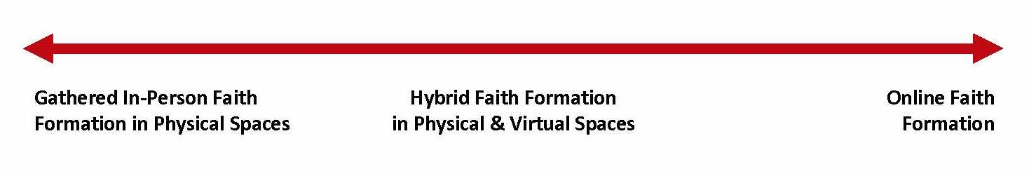
Hybrid Programming
Synchronous and Asynchronous
Gathered Programming
Hybrid Programming
Gathered & Online
Online Programming

Slide 60
One Program, Multiple Formats
Large group physical gathering: People gather at church for a program, presentation, experience + Live Stream + Video Recording
Small group physical gathering: People gather in small groups in homes or coffee shops or other conducive setting, watch the video, read and reflect on the content, and discuss the content.
Small group online setting: People gather online in a small group (Zoom) to watch the video together, read, reflect, and discuss.
Hybrid: People watch the video and read an article on their own, share reflections in a Facebook group (asynchronous), meet together to discuss the program (synchronous).
Online independent: People complete the learning program on their own.

Slide 61
Hybrid: Process
Preparing
Experiencing
Living
How will you sustain/extend the event?
What types of experiences, programming, activities, and resources will you develop to prepare people for the event?
How will you facilitate or guide people’s experience of the event?
What types of experiences, programs, activities, and resources will you offer people?
Independent, small group, large group
Online playlists
Independent, small group, large group
Online playlists
Physical and online settings
Physical and online settings
How will you design the event or utilize an existing event?
Type of Experiences: sacraments, Sunday worship, Church year, family programs, parent programs, etc.

Slide 62
Hybrid: Multi-Session Programming
Week 1
Presentation
Gathering with live stream
(video available)
Week 2
Online Learning Playlist
Week 3
Small Group Discussions
(in-person or online)
Week 4
Continued Learning (playlist)
Sharing Learning
Add a Facebook Group or other online meeting space for sustained interaction and connection

Slide 63
Hybrid: Monthly Plan
Week #1. Family Centered Gathering at Church (2-2 ½ hours)
Week #2. At Home Learning with Digital Playlist
Week #3. Age Groups Gathered Session at Church
Week #4. At Home Learning with Digital Playlist

Slide 64
Hybrid: Flipped Approach
Individual, Family, or Small Group Online
Playlists
Exploring the Content
- print, audio, video, activities
Gathered Program in Physical Space
Applying the Content:
Create – Practice - Perform - Participate
Facebook Group or other online meeting
space for sustained interaction and connection

Slide 65
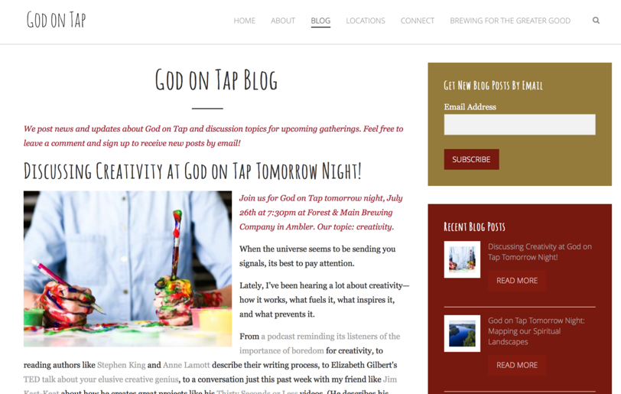
“Flipped” Outreach Initiative

Slide 66
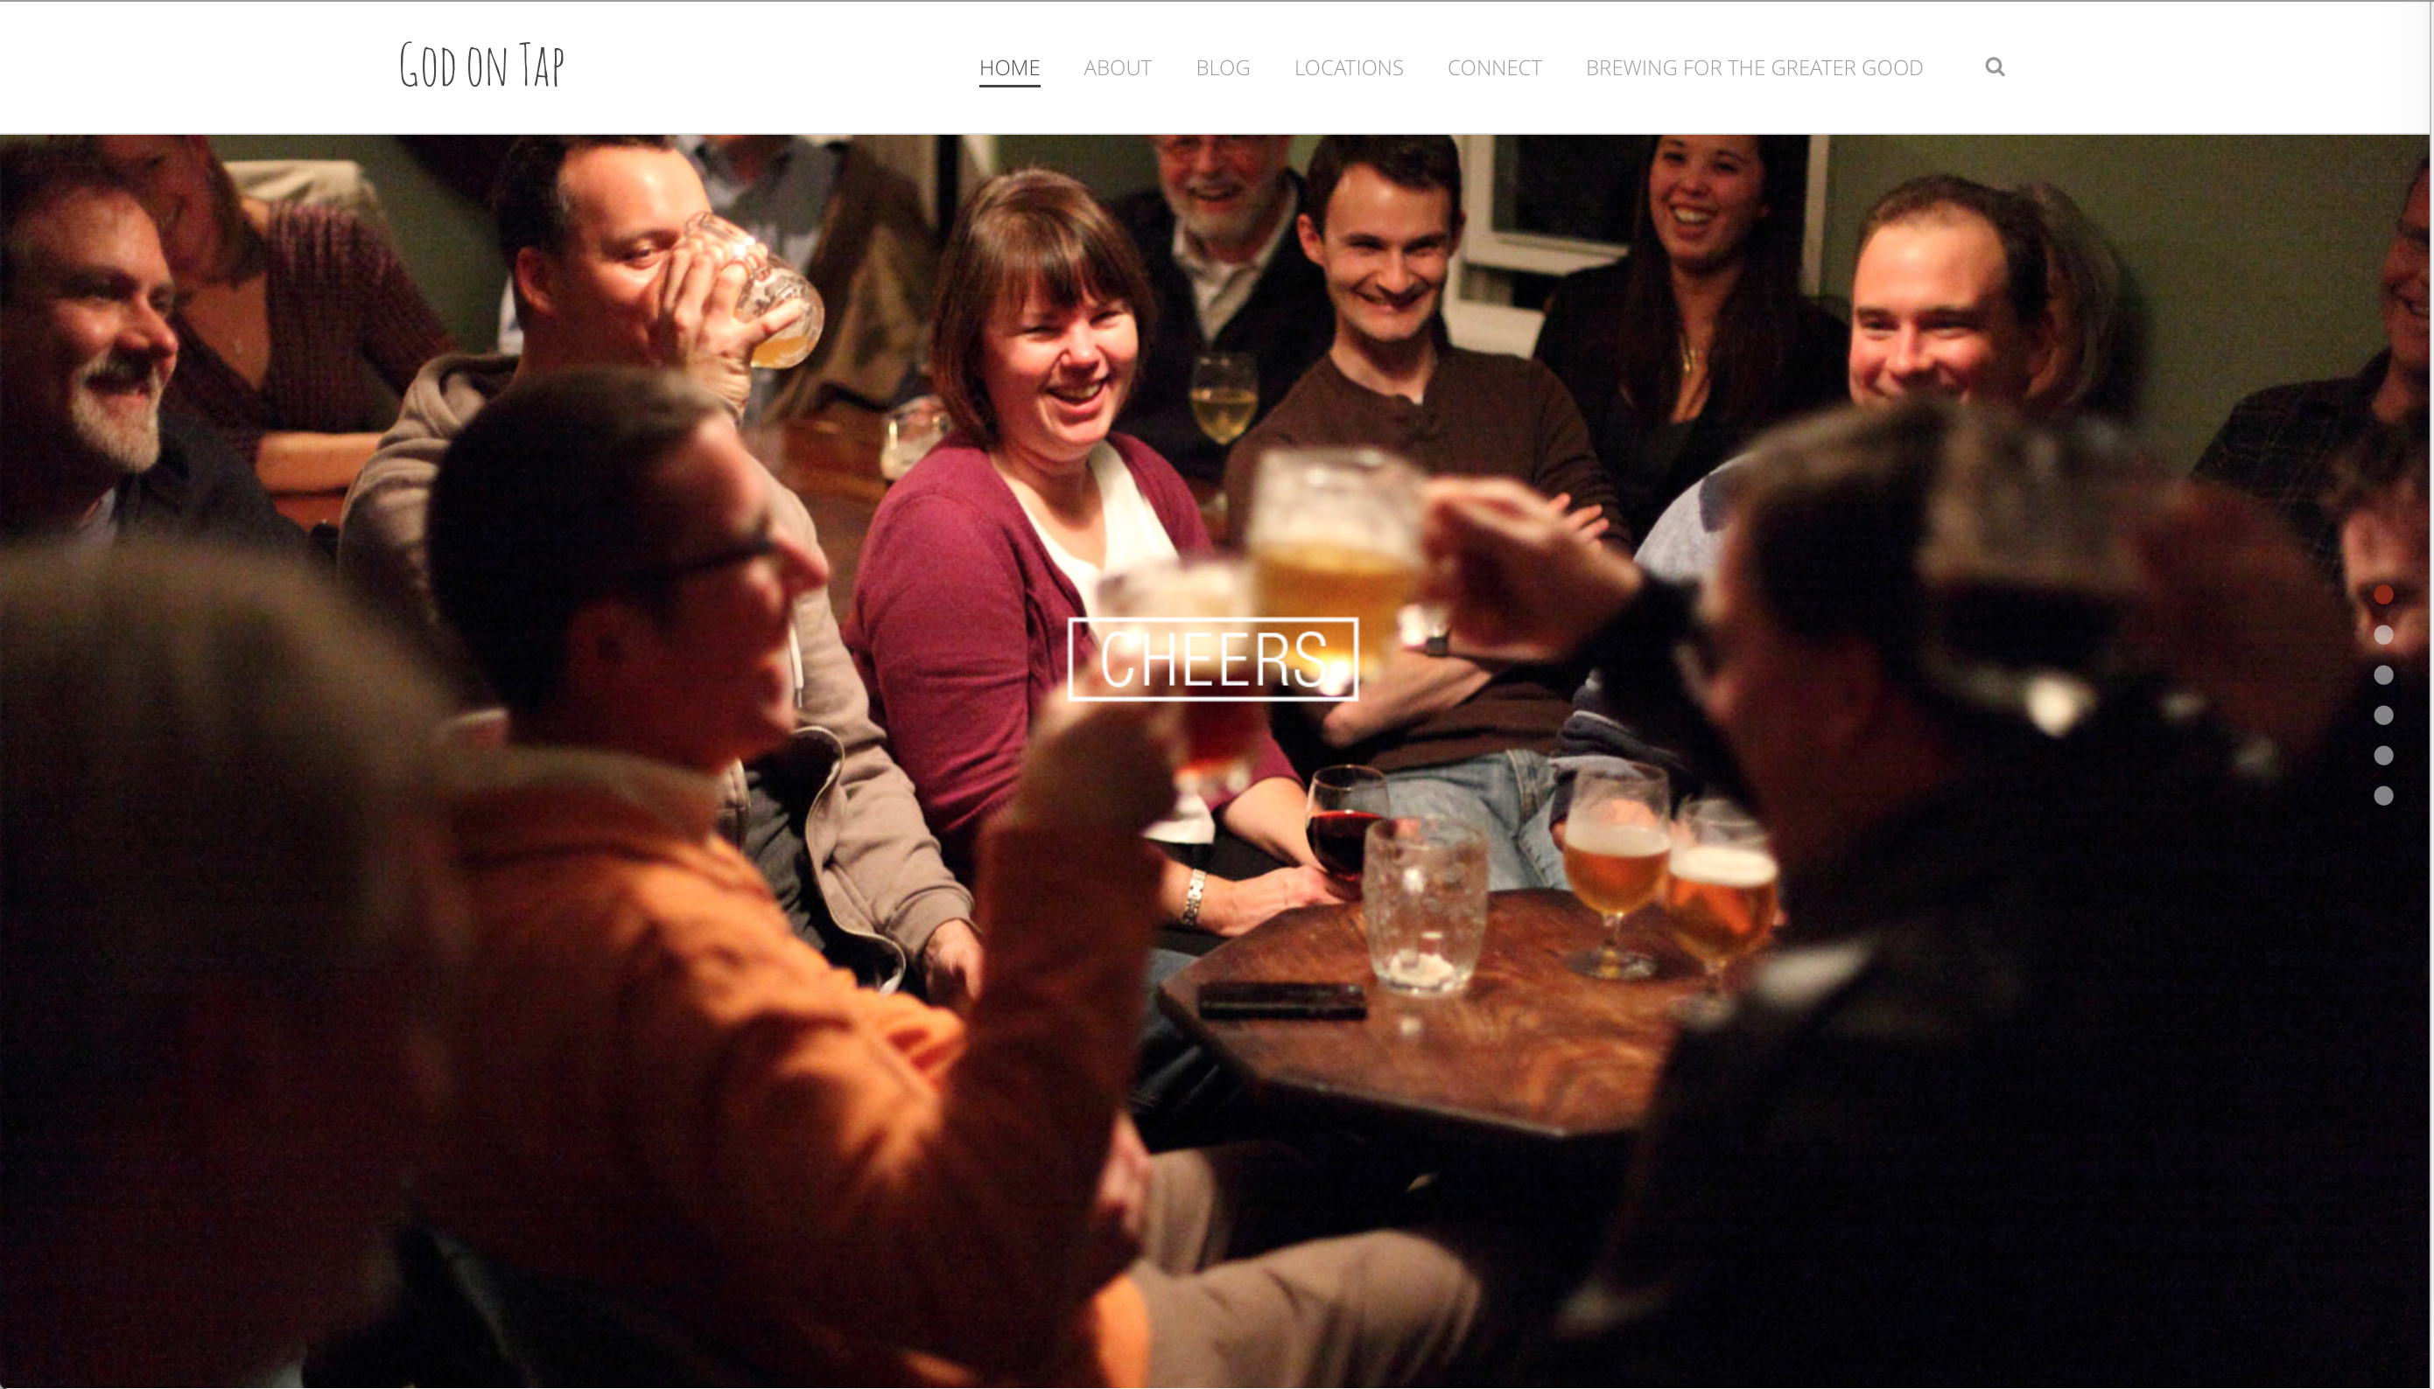
“Flipped” Outreach Initiative

Slide 67
“Flipped”
Confirmation Program
On Your Own: Engage young people with a monthly learning playlist—watching videos, reading short articles, praying, writing reflections in a journal—on the theme.
In a Small Group: Have young people participate in one online small group experience to discuss the content in the playlist and what they are learning.
In a Large Group: Involve young people in a monthly meeting with all groups for community sharing, interactive activities, short presentations, and ideas for living faith.

Slide 68

Our Confirmation preparation program has two components: Once a month in-person classes and an online study. The online study is a place for students to develop their faith weekly by completing multi-media lessons which include videos, reading, Saint reflections, multiple-choice questions and online small group discussions. Each small group has their own online space to discuss faith topics, ask questions, and pray for one another.
  Class Sessions - Once a month (7 in total/year)
  Online Sessions - 3 per month
  “Insight” Youth Group Meetings - Attend 3 per year
  Service Projects - 2 per year
  Retreat - Year 1 and 2

Slide 69
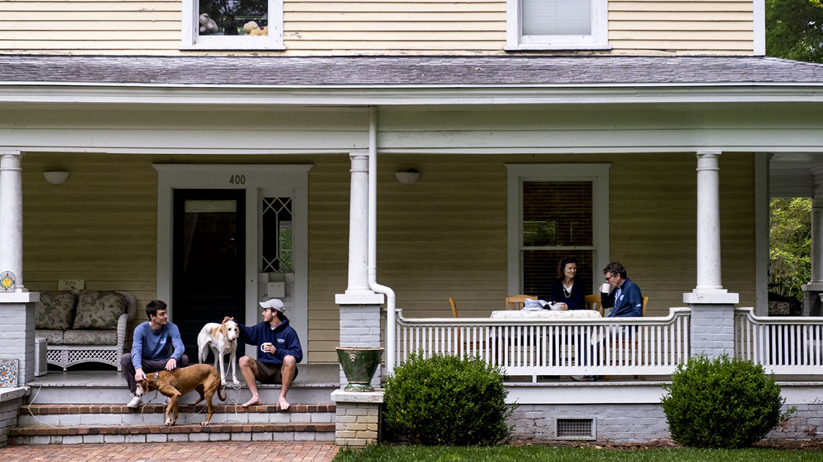
Build Front Porch Experiences
for the Community

Slide 70
Becoming a Community
Learning Center
Move church programs out into community spaces
Open-up church programs to the whole community
Create community-based programming
  Parenting programs and resources
  Mental health programs
  Life skills courses for teens and young adults
  Career and life mentoring or coaching, especially for young adults
  Events for families or the whole community: concerts, movie nights, community-wide service projects, art, drama, etc.
  Programs and activities designed for older adults at the senior center or adult living center or nursing home.
  Dinner Church ministry that brings people together over a meal to share stories, build relationships, and engage spiritually.

Slide 71
Implementing &
Building Capacity

Slide 72
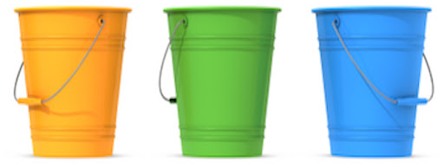
Planning sustain – enhance – expand – create
(and stop things that aren’t working)
Short-Term Planning – ideas that can be integrated into existing plans and programs OR can be designed and implemented quickly in the 2022-23 program year
Mid-Term Planning – ideas that need more design time and that can be implemented within one or two years (2023-24)
Long-Term Planning – ideas that need design time, piloting and testing, and then implementation over the next several years

Slide 73
Involvement Over Time
Year One
Year Two
Year Three

Slide 74
Innovation Design Process
Stanford School of Design
Empathize
Define
Ideate
Test
Prototype

Slide 75

Creating & Sustaining New Projects
Follow the bright spots:
  When creating investigate what’s working and clone it.
  When sustain, collect feedback (stories, audio, photos)
  and share it widely
Point to the destination:
  Change is easier when you know where you’re going and why it’s worth it.
  Paint a picture of what’s happening in people’s lives because of the new project.
Script the critical moves:
  Don’t think big picture, think in terms of specific behaviors.
  Guide the team through the steps.
Find the feeling:
  Knowing something isn’t enough to cause change. Make people feel something. Build an emotional and rational case for change.
Plan for small wins that lead to significant innovations.

Slide 76
Planning Template
This design process uses the following template to develop implementation plans for each goal:
Goal: What do we want to accomplish?
Strategies/Activities: How we will accomplish the objectives over three years?
  Year 1
  Year 2
  Year 3
Personnel: Who will lead and implement the objectives?
Resources: What resources are needed to implement the objectives?

Slide 77
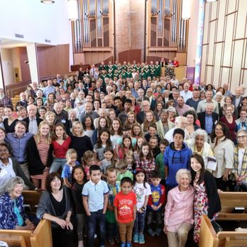
Build Capacity

Slide 78
Capacity Assessment
What capacities do we require to implement our ministry plans for the coming year?
  What will our plans require of the pastor and professional ministry leadership (competencies, skills, processes and procedures)?
  What volunteer leaders will be required for our plans, and what competencies (knowledge and skills) and resources will they need to perform effectively (tools and resources)?
  What material resources (facilities, communication, technologies, print and digital resources) will our plans require?
  What financial resources will our plans require?
What capacities (resources) do we already have available to us for the coming year within our church community (people, programs, resources, finances), and outside our church in other religious congregations, schools and colleges, community organizations, denominational agencies—regional and national?
What capacities (resources) do we need to develop or enhance in order to implement our plans and flourish as a community (or ministry)?

Slide 79
Capacity Building
Utilize the abundance of resources – print, audio, video, digital – for lifelong faith formation.
Utilize the resources in the community and other congregations.
Cultivate the gifts in the church community: everyone’s a learner and everyone’s a teacher.
  Work with the time commitments that fit people’s schedules.
  Offer a variety of roles with varying levels of responsibility and time commitments.
  Develop leadership roles with fewer tasks and divide up a large leadership role into smaller responsibilities.
  Design a program with a primary leadership role (teaching, presenting, facilitating activities) and support roles.
  Design programming in shorter units of time.

